Slide 1








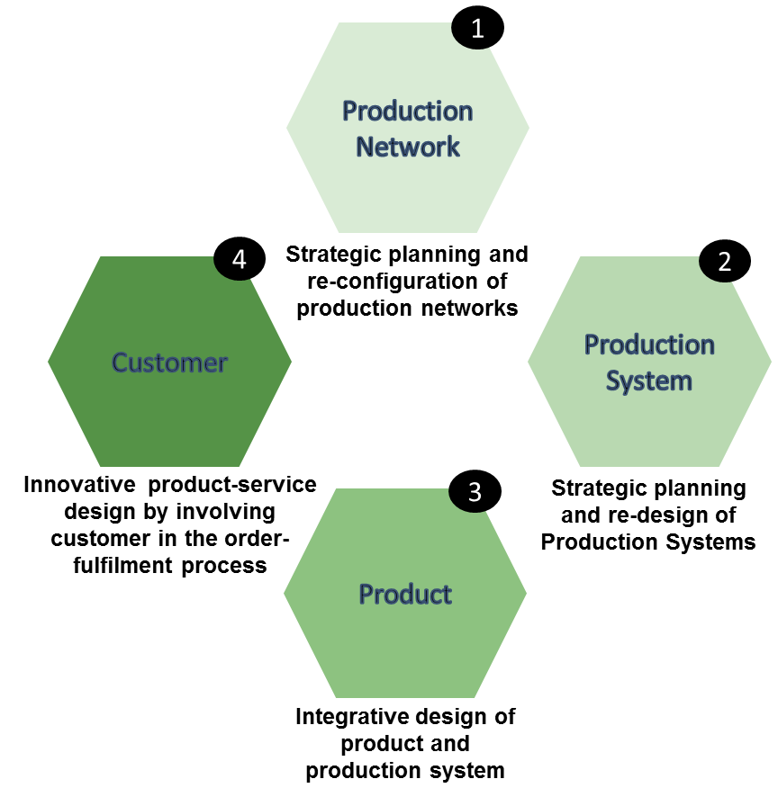









Project Consortium
General Information
Project duration:
01.01.15 – 31.12.17
Grant amount:
€ 5.1 m
Industry Partners
Customer-driven design of product-services and production networks to adapt to regional market requirements
Website
http://www.h2020-proregio.eu/
Overall Concept
Follow us: @ProRegio_H2020
www.facebook.com/ProRegioProject/
Contact Us
Technology Providers
Project Coordinator
wbk Institute of Production Science
Karlsruhe Institute of Technology (KIT)
Kaiserstrasse 12, 76131 Karlsruhe, Germany
Contact persons:
Jan Hochdörffer
Phone: +49-721-608-44016
E-Mail: jan.hochdoerffer@kit.edu
Jens Bürgin
Phone: +49-721-608-44013
E-Mail: jens.buergin@kit.edu
Research Institutions
Dissemination Leader
Laboratory for Manufacturing Systems & Automation, University of Patras
Patras 26500, Greece
Contact person:
Professor Dimitris Mourtzis
Phone:+30-2610-997262
E-Mail: mourtzis@lms.mech.upatras.gr
This project has received funding from the European Union’s Horizon 2020 research and innovation programme under grant agreement no. 636966.

Slide 2
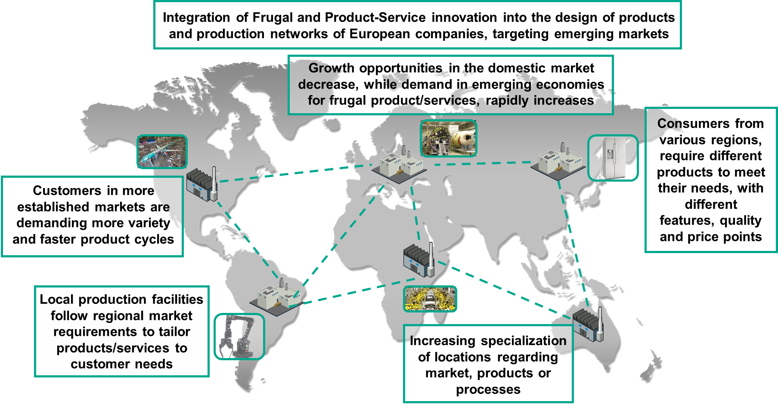
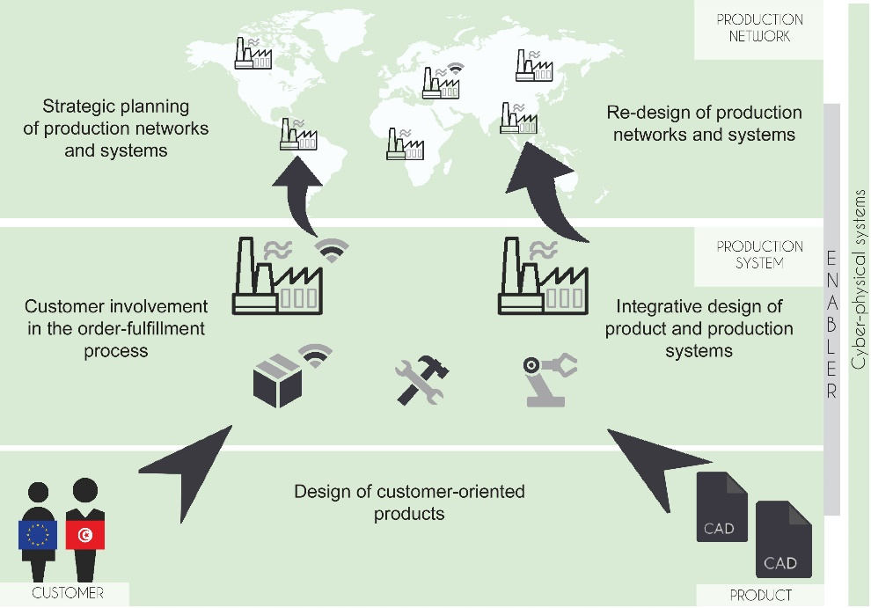
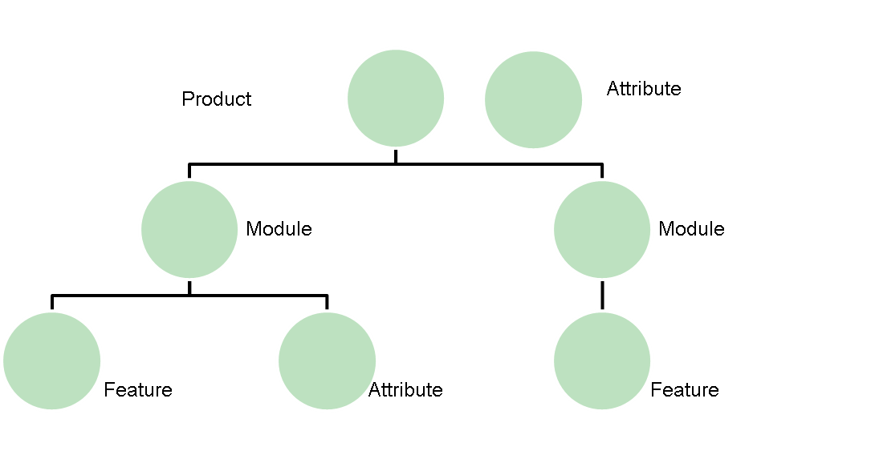
Main Challenges
Industrial Benefits
The ProRegio approach will increase the attractiveness of companies:
By increasing customer satisfaction by providing more “power” to the customer comparable to effects of social media
By increasing supplier loyalty by even stronger integration into the order fulfilment process
By offering new added value services that make their products more attractive to different customers segments especially for emerging regions
By increasing ability to export into emerging countries all around the world and is doing so the project will help to stabilize EU’s exports
Main Objectives
The Approach
Costumer integration in the product development process
Development of integrated product and production adaptions regarding site-specific conditions and technology options
  Innovative product-service design by incorporating customers in the order-fulfilment processes
  Optimal design of production systems and allocation of production processes to production sites
PRODUCTION NETWORK
Industrial Impact
The ProRegio approach will increase the competitiveness of companies:
Reduction of production costs
Shortening of throughput times
Improvement of delivery reliability through more transparent production processes
Shorten time-to-market of customized products/services
PRODUCTION SYSTEM
CUSTOMER
PRODUCT

